Slide 1
CS 557 Assignment 4 Texture Mapping Report
Kyle Vansice/Matthew Gardner/Jiale Feng

Slide 2
Problem 1 Multi-texturing
Tex_color: the deathstar texture
tex_color_light: the wolf
tex_color_new: the gradient
Notes:
Three functions were tested for blending of the images, and are given below. Tex_color represents the deathstar texture, tex_color_light represents the wolf, and tex_color_new represents the gradient.

Slide 3
Blend Function 1:
color = 0.1 * pass_Color + tex_color + tex_color_light + tex_color_new
Notes:
This function was provided by Dr. Radkowski, and simply uses a pass color while adding the color values for each image. It creates the following composite image, which obscures and over-exposes the textures.

Slide 4
Blend Function 2:
color = tex_color * tex_color_light * tex_color_new
Notes:
This function was also provided by Dr. Radkowski, and utilizes simple multiplication of pixel color values for each image. The result nicely shows the overlay of each image, but the gradient is somewhat obscured. For this reason, a third blend function was tested.

Slide 5
Blend Function 3:
color = tex_color / tex_color_light * tex_color_new;
Notes:
Because the wolf overlaid onto the moon created such a dark image when multiplying, we decided to divide the two instead. This effectively inversed the image (since they were likewise color topologies) and created a light on dark contrast. The gradient was then multiplied to create a color scheme of gradient on light and gradient on dark.

Slide 6
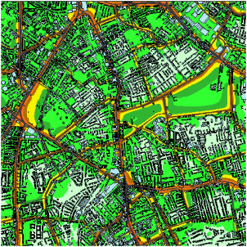
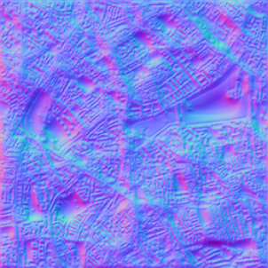
Problem 2 Noise Map

Slide 7
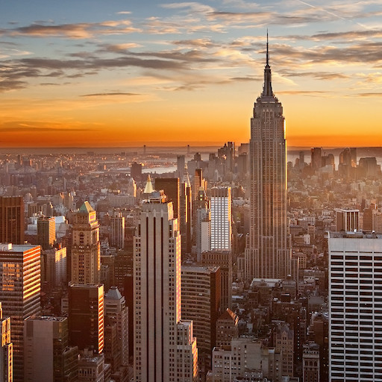
Landscape (Color map)

Slide 8
Goal
Emphasize the sunset with some yellow specular light
Maintain detail of the Noise map
Try and have roads and buildings visible in the distorted image
Maintain the general landscape of the original image
Preserve the skyscrapers, sunset, etc.

Slide 9
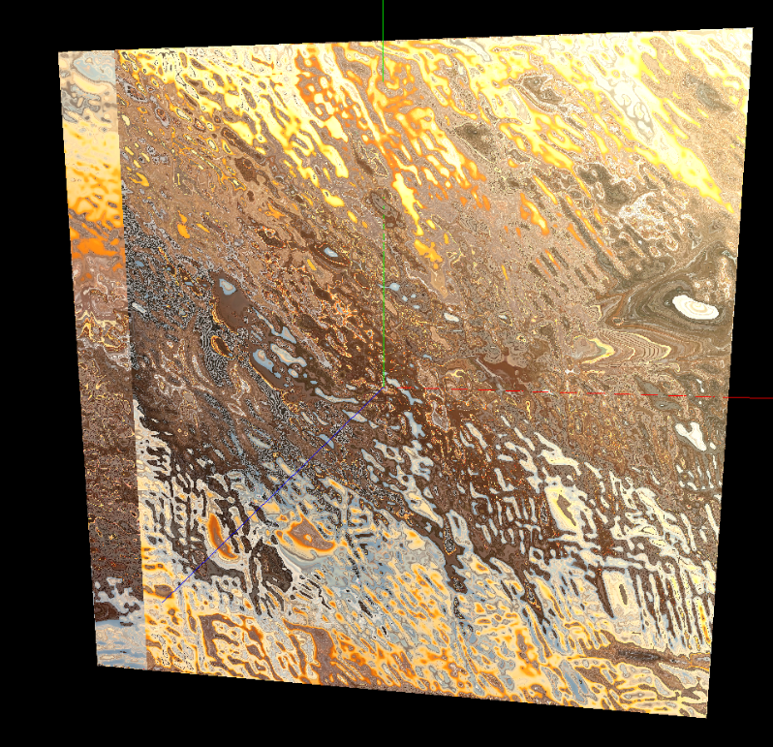
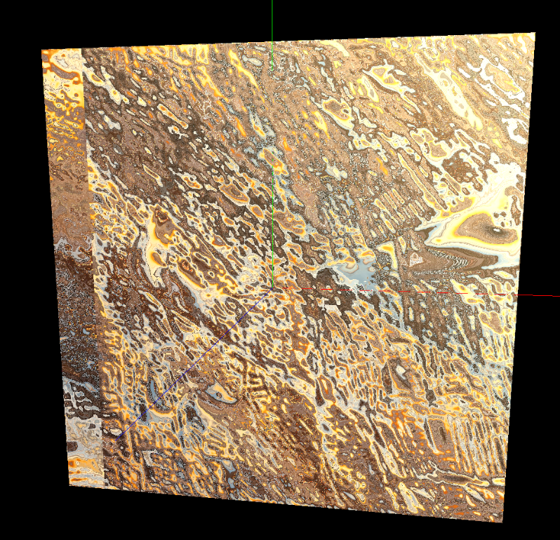
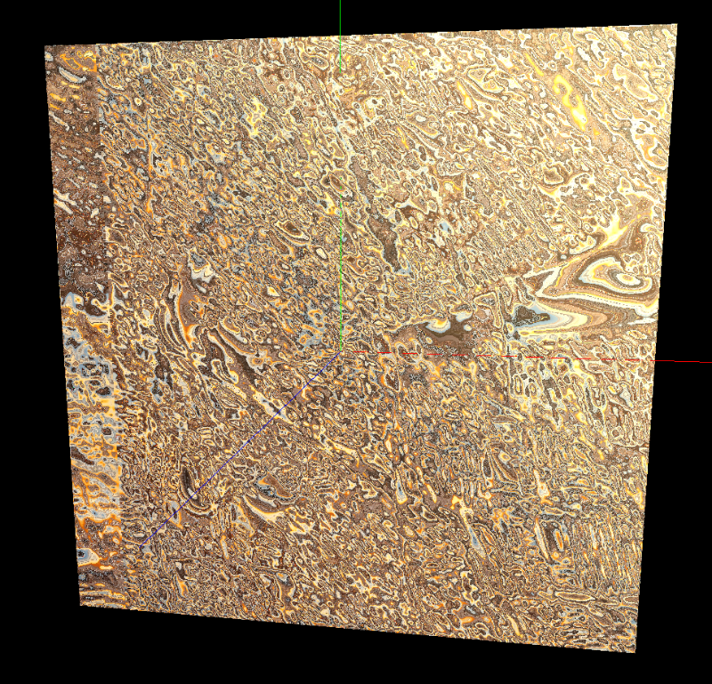
Results: Extreme Displacement Functions
x1
x2
x5
Notes:
Normalized vector x 1/2/5
Using only the normalized noise vector, we can preserve detail of the Noise map, up to certain point.
…But, the original landscape is ruined

Slide 10
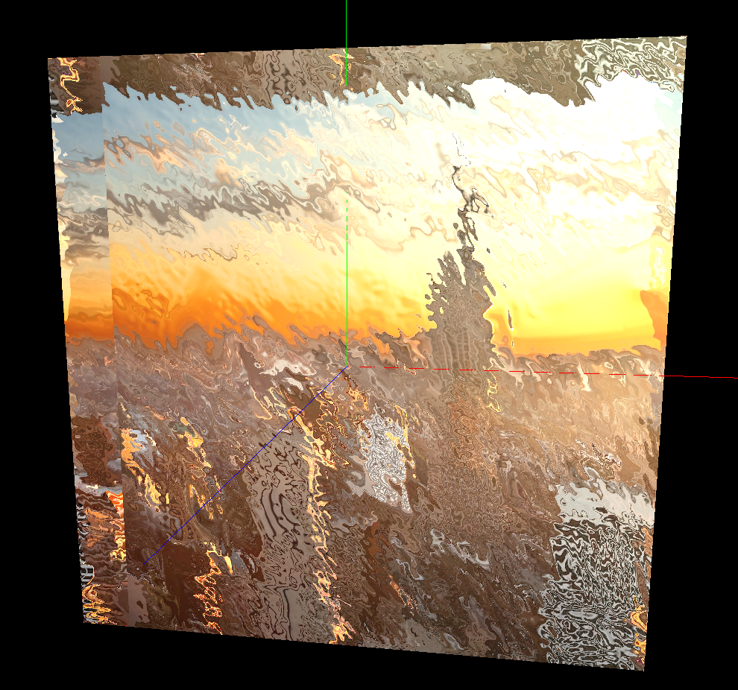
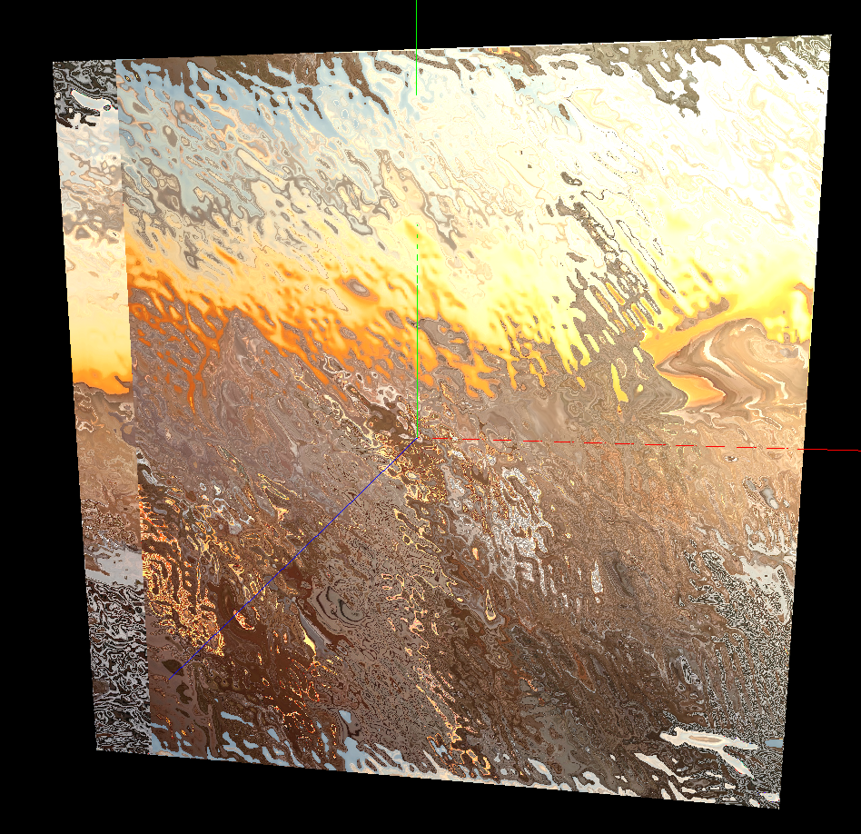
Results: Balancing out noise
noiseVec * .5
(noiseVec * 3.0 – 2.0) * .1
Notes:
After trying many equations for the noiseVec…
Must compensate how much detail of the noise map with how much detail of landscape.
When combined with specular light…looks like rippled water with a reflection of the landscape...nice!

